Slide 1


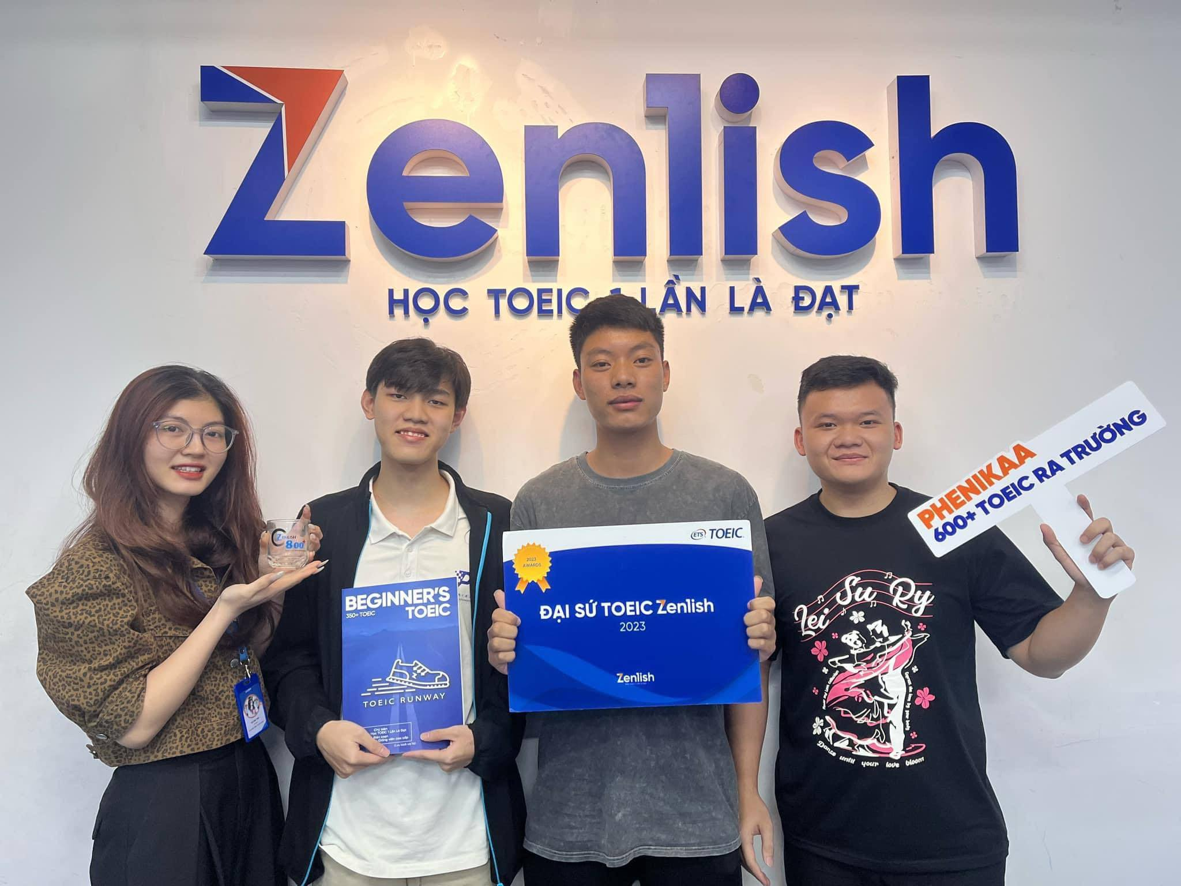
ZENLISH – HỌC TOEIC 1 LẦN LÀ ĐẠT
BEGINNER’S TOEIC
LESSON 4

Slide 2
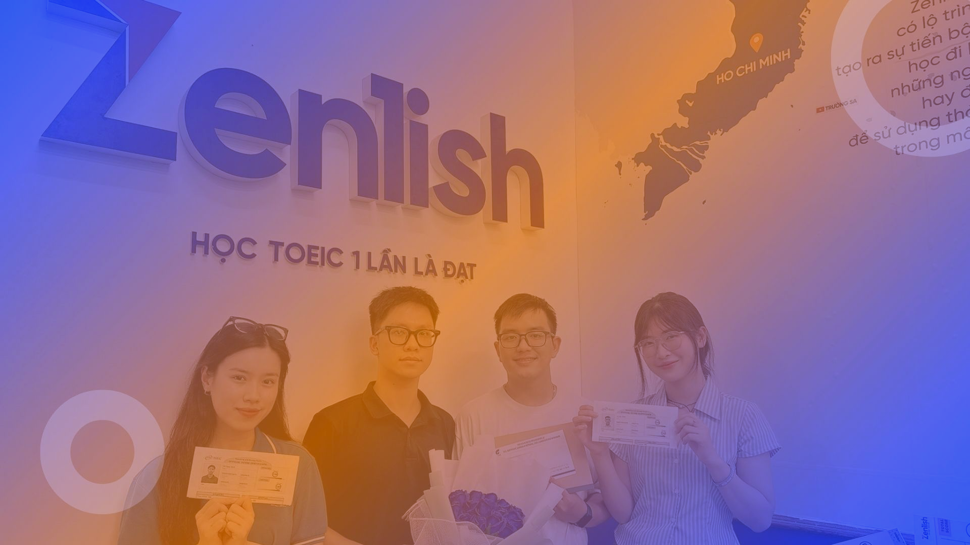


ZENLISH – HỌC TOEIC 1 LẦN LÀ ĐẠT
BEGINNER’S TOEIC
LESSON 4
CÂU HỎI NGHI VẤN YES/NO

Slide 3

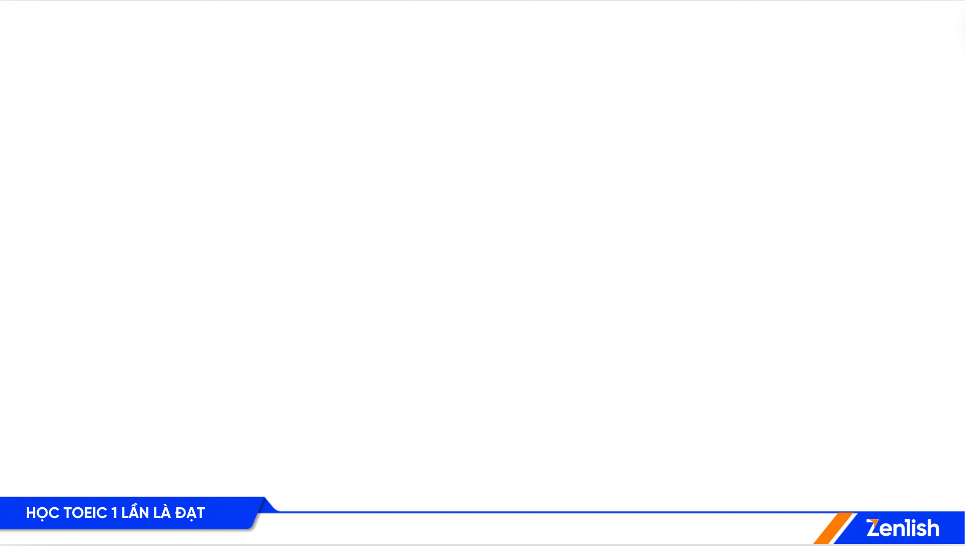

NỘI DUNG BÀI HỌC
1
Ví dụ
Từ vựng
3
2
Lý thuyết
Thực hành
4

Slide 4
NỘI DUNG BÀI HỌC
1
Ví dụ

Slide 5

1
Is Ms. Romano coming to the reception tonight ?
Is Ms. Romano coming to the reception tonight?
A. I’m not sure
A. I’m not sure
B. I was free yesterday
Lưu ý:
Ở câu hỏi: Nghe hiểu dựa vào trợ V, S và V đi kèm
Ở đáp án đúng: cụm từ diễn tả không chắc, không rõ
Lesson 1

Slide 6
2
Don’t you have to catch a train soon ?
Don’t you have to catch a train soon ?
A. I cancelled my trip
A. I cancelled my trip
B. Sorry, I don’t have any
Lưu ý
Trong câu hỏi: Dựa vào cụm động từ “catch a train”
Trong đáp án: Trả lời giao tiếp: sự kiện đã bị hủy, không diễn ra nữa.
Lesson 1

Slide 7
3
Michael, is this your coat ?
Michael, is this your coat ?
A. Because it’s cold outside
B. No, mine’s brown
B. No, mine’s brown
Lưu ý
Trong câu hỏi: dựa vào cụm danh từ “your coat”
- Trong đáp án: Dùng “Yes/No” + vế xác thực
Lesson 1

Slide 8
4
Do you have this shirt in a different size?
Do you have this shirt in a different size?
B. No, mine’s brown
A. Yes, we also have it in medium
B. Sure, she can go
Lưu ý
Trong câu hỏi: dựa vào cụm danh từ “different size”
Trong đáp án: Dùng “Yes” + vế xác thực
Lesson 1

Slide 9
NỘI DUNG BÀI HỌC
2
Lý thuyết

Slide 10
CÁCH NHẬN DIỆN ĐÁP ÁN ĐÚNG
Đồng ý hoặc từ chối
Xác nhận trực tiếp
Yes/No

Slide 11
NỘI DUNG BÀI HỌC
3
Từ vựng

Slide 12
TỪ VỰNG
Do you want [need] to do A? Do you want me to do A? Do you have A? Did you buy [get] A? | Yes, that’d be great. Yes, I’d appreciate that. How many do you need? Yes, last week.

Slide 13
TỪ VỰNG
Have you finished A? Have you seen A yet? Are you available for A? Is there A in the store? Sure./Okay./All right./I think so/ Not yet./Not really./Unfortunately. | I did that this morning. No, I’m going to see it tomorrow. Yes, I’d be happy to. You can follow me.

Slide 14
NỘI DUNG BÀI HỌC
4
Thực hành

Slide 15
ZENLISH – HỌC TOEIC 1 LẦN LÀ ĐẠT
BEGINNER’S TOEIC
LESSON 4
TEST TACTIC

Slide 16

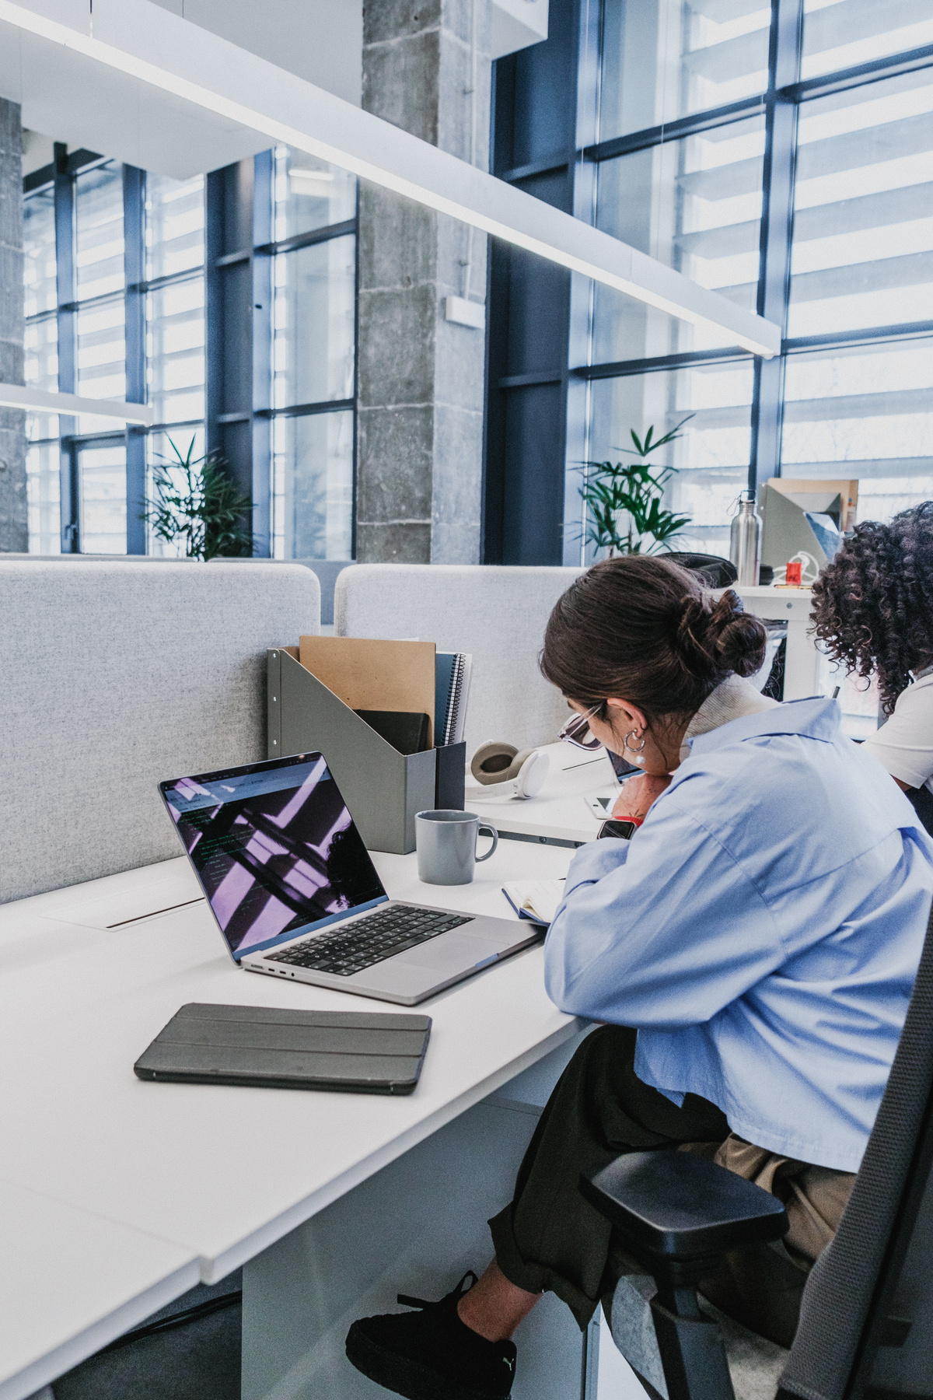
1
Are you free to join me for breakfast?
Are you free to join me for breakfast?
A. I joined it last year
B. No, it’s not free
C. Sorry, but I’m late for work

Slide 17
2
Did you attend the research presentation?
Did you attend the research presentation?
A. No, I’ve been out of town
B. I didn’t bring a gift
C. Can I have your attention, please

Slide 18
ZENLISH – HỌC TOEIC 1 LẦN LÀ ĐẠT
BEGINNER’S TOEIC
LESSON 4
ACTUAL TEST

Slide 19
1
Is Ms. Burns likely to come to the meeting?
Is Ms. Burns likely to come to the meeting?
A. Probably not
B. Yes, I like it a lot.
C. We came here yesterday

Slide 20
2
Do I have to fill out these forms now?
Do I have to fill out these forms now?
A. No, thanks. I am already full
B. They have been informed
C. Yes, we need them for your interview

Slide 21
3
Have the emergency exits been inspected?
Have the emergency exits been inspected?
A. Only in an emergency
B. Through the main entrance.
C. Yes, everything is fine

Slide 22
4
Do you happen to know where the fitness center is?
Do you happen to know where the fitness center is?
A. No, it doesn't fit
B. He is in good condition
C. Yes, it is around the corner

Slide 23
5
Did that new book get a good review?
Did that new book get a good review?
A. No, I haven’t booked my flight.
B. Yes, a few of us
C. The one I saw was pretty favorable.

Slide 24
6
Are these instructions clear?
Are these instructions clear?
A. No, could you repeat them?
B. It is already clean
C. He is a good teacher

Slide 25
7
Do you like the theater that just opened?
Do you like the theater that just opened?
A. No, she lives far away
B. I sold it last year
C. Yes, I think it is wonderful

Slide 26
8
Should I wear a tie tonight?
Should I wear a tie tonight?
A. No, it is not a formal event
B. Excuse me, do you have the time?
C. I’ll be at the hotel

Slide 27
9
Can you tell me when the plays start?
Can you tell me when the plays start?
A. How about another time?
B. It begins at 8
C. She started at a young age

Slide 28
10
Should I ask Ms. Okuda to sign this contract?
Should I ask Ms. Okuda to sign this contract?
A. The design is very nice
B. No, she is not in today
C. It is making contact

Slide 29
11
Do you need help with this computer?
Do you need help with this computer?
A. Yes, I am having trouble running this program
B. Well, I usually take a commuter train
C. The one over there isn’t being used

Slide 30
12
Do you want to order lunch from the Mexican restaurant?
Do you want to order lunch from the Mexican restaurant?
A. The delivery arrived yesterday.
B. That was an excellent meal
C. No, I brought my lunch today

Slide 31
13
Is there a manual for the new projector?
Is there a manual for the new projector?
A. If he is leading the project
B. Sure, it’s in my briefcase
C. She has the latest machine

Slide 32
14
Will we need to make changes to the budget?
Will we need to make changes to the budget?
A. Here is your change
B. I couldn’t make it yesterday
C. I think this is fine

Slide 33
15
Are you going to install the equipment yourself?
Are you going to install the equipment yourself?
A. A more efficient assembly line
B. No, the manufacturer will do that
C. 7000 dollars

Slide 34
16
Can you tell me which computer I should buy?
Can you tell me which computer I should buy?
A. We called a technician
B. I recommend a laptop
C. A 2 – year warranty

Slide 35
17
Can’t we see the movie tonight?
Can’t we see the movie tonight?
A. The Garden Theater
B. Front row seats
C. I am afraid I have other plans

Slide 36
18
Isn’t Mr. William a little late?
Isn’t Mr. William a little late?
A. Yes, he should be here by now
B. Yes, it is a bit small
C. Late yesterday afternoon

Slide 37
19
Don’t you want to bring a book to read?
Don’t you want to bring a book to read?
A. No, I don’t think so
B. Yes, I have read it
C. We already booked

Slide 38
20
Can’t Mr. Lee meet with us before noon?
Can’t Mr. Lee meet with us before noon?
A. I made the introductions
B. No, he is busy all morning
C. The upstairs meeting area

Slide 39
21
Aren’t your colleagues going to join us for lunch?
Aren’t your colleagues going to join us for lunch?
A. They enjoyed the trip
B. You are very welcome
C. Yes, they are looking forward to it

Slide 40
22
Didn’t you see Tony Flynn’s Presentation?
Didn’t you see Tony Flynn’s Presentation?
A. It was a lovely gift
B. Unfortunately, I arrived too late
C. Try sitting somewhere else

Slide 41
23
Isn’t Karl planning to come to the party?
Isn’t Karl planning to come to the party?
A. As far as I know he is
B. He needs both parts
C. The café he went to last time

Slide 42
24
Didn’t you want to write the project summary?
Didn’t you want to write the project summary?
A. No, you should turn left
B. I remember that writer
C. I did, but I could use your help

Slide 43
25
Weren’t you at the meeting this morning?
Weren’t you at the meeting this morning?
A. No, I was with the client
B. I didn’t meet him
C. Room 501

Slide 44
THANK YOU

